Slide 1
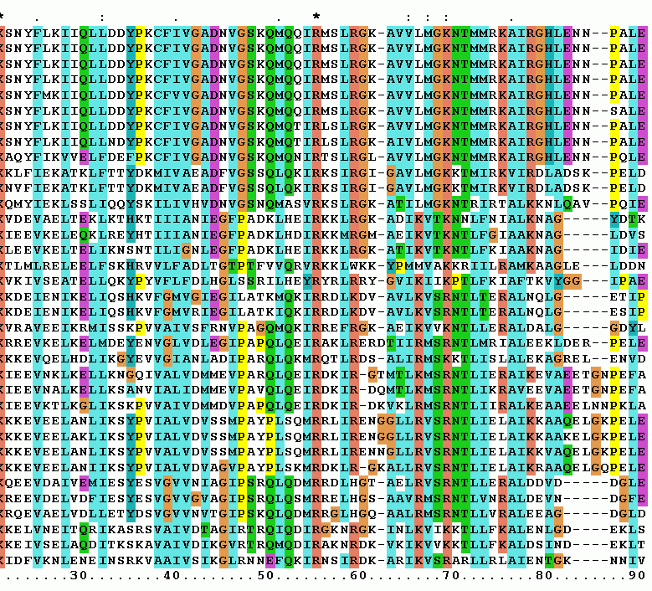
MAFFT and MUSCLE(S) Multiple Sequence Alignment Tools
Presentation by Evgeniia Kachmazova and Chioma Lucy Nwachukwu
Course: Computational Biotechnology (Mol981_2026)

Slide 2
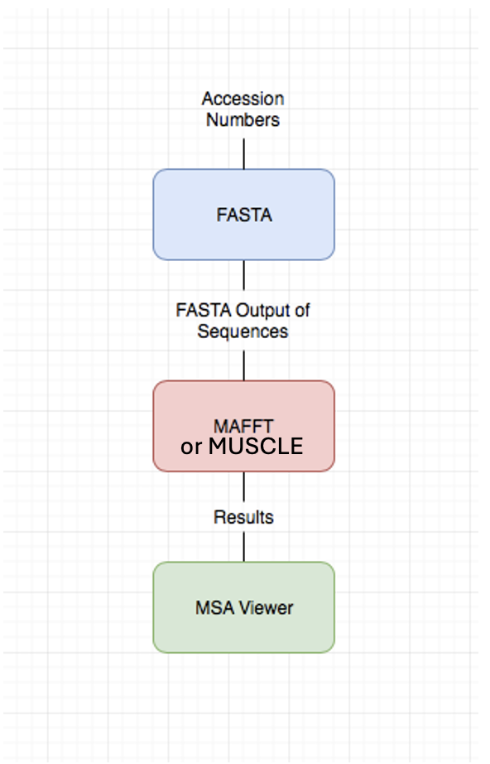
Multiple Sequence Alignment (MSA) is the alignment of three or more biological sequences (protein or nucleic acid) of similar length. From the output, homology can be inferred and the evolutionary relationships, as well as structural and functional similarities between the sequences can be studied.
Input: unaligned sequences
Output: aligned sequences

Slide 3
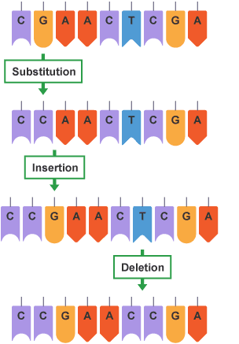
Single Gene Mutations
Sequence alignments reveal evolutionary changes such as point mutations, insertions, and deletions, and help identify conserved regions and protein domains

Slide 4
Interpreation of MSA
Conserved regions stay unchanged between sequences
Indels mutations are represented as gaps
Sequence A: MKTAA
Sequence B: MKTTAA
To align them:
MKT-AA MKTTAA
The gap suggests:
either Sequence A lost a residue,
or Sequence B gained one during evolution

Slide 5
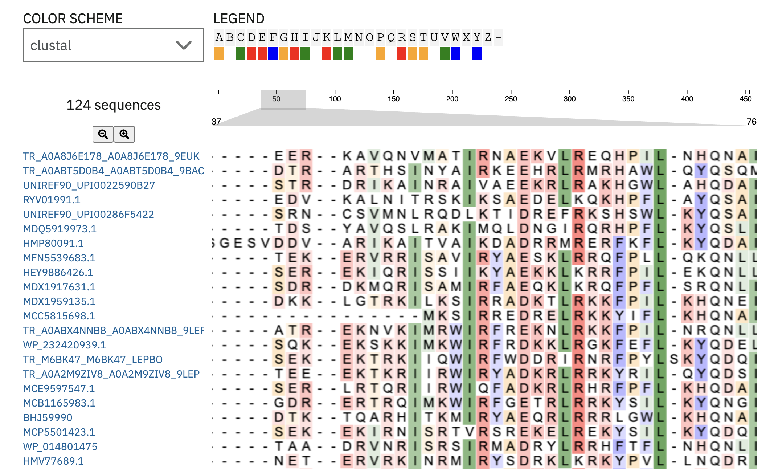
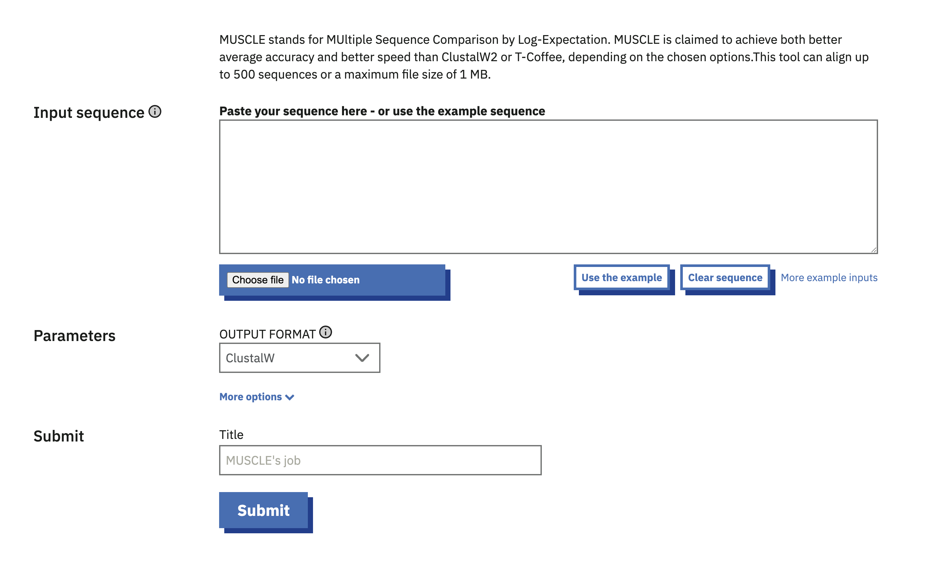
MUSCLE

Slide 6

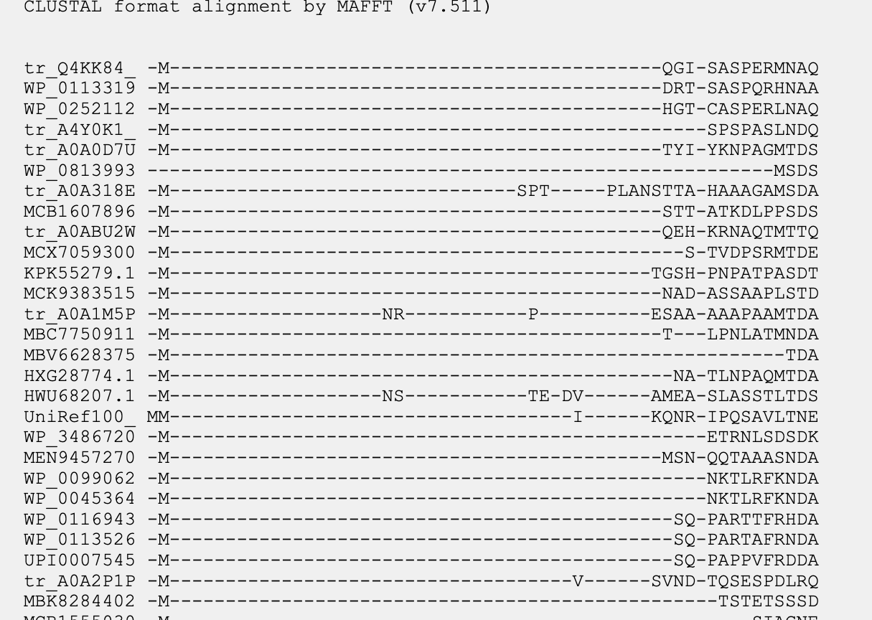
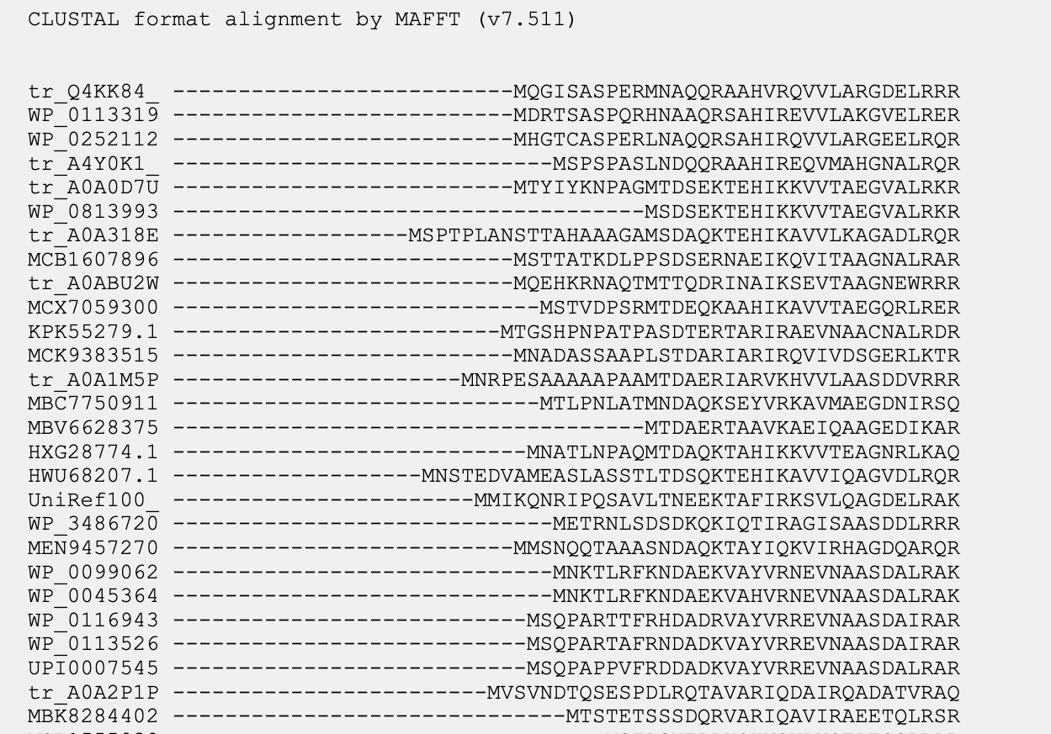
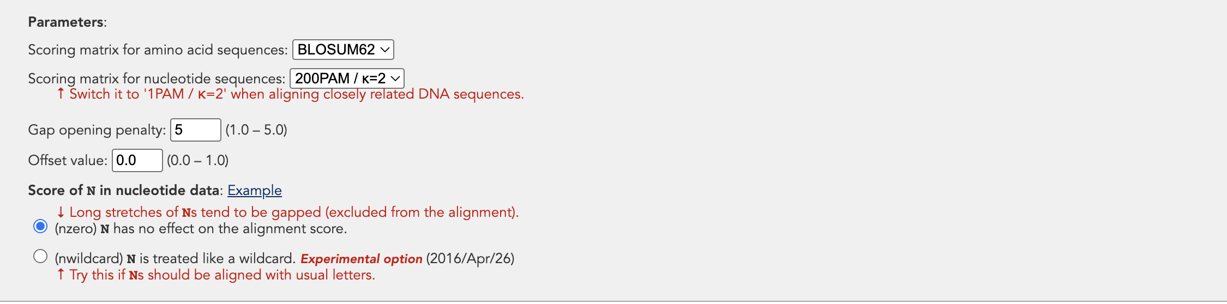
MAFFT: MSA with different penalty factors
Gap opening penalty = 1
Gap opening penalty = 5

Slide 7
Comparison of Alignments
MUSCLE
MAFFT
MAFFT produced a more compact and interpretable alignment, while MUSCLE introduced more local gaps in variable regions. Both tools identified the same conserved motif, but MAFFT appeared more stable for this larger protein dataset.

Slide 8
How MAFFT Works Multiple Alignment using Fast Fourier Transform
1. Sequence input: FASTA sequences retrieved via accession numbers from NCBI
2. FFT Scoring: Sequences converted to numerical vectors; correlations found using Fast Fourier Transform to detect homologous regions.
3. Guide Tree: Pairwise similarity scores build a UPGMA guide tree to order alignment.
4. Progressive Alignment: Sequences aligned progressively along the tree; iterative refinement improves accuracy (L-INS-i mode)

Slide 9
How MUSCLE Works
Multiple Sequence Comparison by Log-Expectation — v5 introduced ensemble-based alignment
1.Draft Progressive Alignment
Kmer-based distances estimate sequence similarity. A UPGMA tree is built from these distances, and sequences are aligned progressively along it to produce a rough first alignment.
2. Improve the Tree
A new distance matrix is computed from the Stage 1 alignment using Kimura distances. A better guide tree is built and used to re-align the sequence improving on the draft.
3.Iterative Refinement (MUSCLE-S / Super
The alignment is split and re-joined repeatedly to refine accuracy. MUSCLE v5's 'super5' mode skips expensive steps for very. large datasets (thousands of sequences), dramatically improving speed while maintaining quality.
MUSCLE v5 can run multiple replicates and ensemble them — reducing alignment uncertainty on difficult datasets

Slide 10
MAFFT vs MUSCLE: When to Use Which?
 | MAFFT | MUSCLE / MUSCLE-S
Algorithm | Fast Fourier Transform + progressive / iterative | Log-expectation scoring + progressive / iterative
Speed | Very fast (FFT-NS-2) Slow but accurate (L-INS-i) | Fast (v5 Super5 mode) Slower for full refinemen
Accuracy | High — best with iterative modes | High — especially on proteins
Sequence types | DNA, RNA, Protein | Primarily Protein (also DNA)
Large datasets (1000s of seqs) | Excellent (--auto flag) FFT-NS-2 recommended | Excellent (Super5 mode) Ensemble reduces error
Gap penalties | Adjustable (opening & extension) | Internally managed
Best use case | Phylogenetic studies, large genomic datasets, RNA | Protein family analysis, high-accuracy protein MSA

